Slide 1
A Tale of Two Droughts
Is Water Efficiency a Mitigation Strategy?
Metro Atlanta’s Experience

Slide 2
Drought
Definition:
Any shortage of water that causes water related problems or complications.

Slide 3
4 Levels of Drought
Meteorlogic
Agricultural
Hydrologic
Socioeconomic

Slide 4
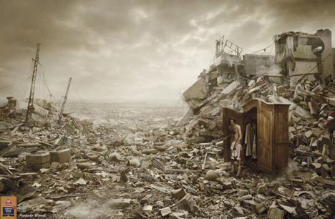
2007
The Apocalypse

Slide 5
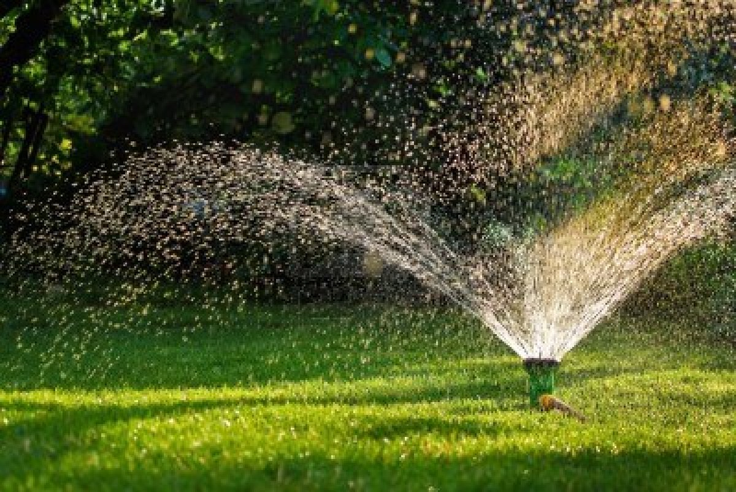
2012
What drought?

Slide 6
It must be raining more this time?
2006 – Beginning of the 2007-2008 Drought
  Rainfall 2006 -48.46-inches
  Rainfall 2007 – 31.85-inches
2011 – Beginning of 2012 Drought
  2011 Rainfall – 39.23-inches
  2012 Rainfall to date- 26.23-inches (we typically get on average another 10 inches before the end of the year)

Slide 7
Metro Atlanta and Drought
Area 99% dependent on surface water.
Height of 2007 drought Lake Lanier evaporating 100MGD
4 million people dependent upon two Federally controlled reseviors
3 million dependent upon Lanier – South Georgia Drought means Lanier must balance the basin to meet all needs.
Lanier 9% of the drainage area 64% of the storage

Slide 8

Drought Response
2007

Slide 9

Drought Response
2012

Slide 10
Lake Levels
September 2012
  Lake Allatoona – 833.58
  Lake Lanier – 1061.37
September 2007
  Lake Allatoona – 827.50
  Lake Lanier – 1059.39 (Lowest level ever 12/26/07 1050.79)

Slide 11
What is the Difference?
Cobb County-Marietta Water Authority’s Water Use
Peak Water Use in 2007 (Pre Outdoor Water Ban)
  148 MGD
Peak Water Use in 2012
  110 MGD
25% Reduction in Water Use

Slide 12
Water Efficiency
Conservation Rates designed to make outdoor water use the most costly
  Drives smarter decisions about landscaping
  Limits overwatering
Incentive Programs
Education Programs
Experience
Policy Changes to encourage efficiency
State Mandates
Successful partnerships

Slide 13
Is efficiency mitigating drought impacts?
A tale of two droughts

Slide 14
Thank you
Kathy Nguyen
Water Resource Manager
Cobb County Water System
Kathy.nguyen@cobbcounty.org
770-429-6244

